Slide 1
Swisscom: Network Incident Network Analytics Postmortem
Describes an incident in terms of what happened, which operational metrics where available, which analytical metrics described the symptoms and what improvements in the network anomaly detection system and network telemetry protocols are proposed.
thomas.graf@swisscom.com
02. November 2024

Slide 2






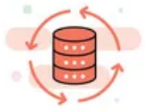

Data Mesh organizes Data in Organizations Enables Network Analytics use cases
Alert
Postmortem
RFC 8632
draft-netana-nmop-network-anomaly-semantics draft-netana-nmop-network-anomaly-lifecycle
Analytical Data draft-netana-nmop-yang-message-broker-integration
Network Device Trend Detection
Verify, Troubleshoot and Notify
Network Anomaly Detection
Network Visualization
Network SLI and SLO
Closed Loop Operation
draft-netana-nmop-network-anomaly-architecture
Operational Data draft-netana-nmop-yang-message-broker-integration
Network Data Collection
Network Telemetry (RFC 9232) IPFIX (RFC 7011, RFC 9487, RFC 9160, draft-ietf-opsawg-ipfix-on-path-telemetry)
BMP (RFC 7854, RFC 8671, RFC 9069, draft-ietf-grow-bmp-tlv, draft-ietf-grow-bmp-path-marking-tlv, draft-lucente-grow-bmp-rel)
YANG-Push (RFC 8639, RFC 8641, draft-ietf-netconf-udp-notif, draft-ietf-netconf-distributed-notif, draft-ahuang-netconf-notif-yang, draft-ietf-netconf-yang-notifications-versioning, draft-tgraf-netconf-notif-sequencing, draft-tgraf-netconf-yang-push-observation-time)

Slide 3
What to monitor Which metrics are collected
« Network operators connect customers in routing tables called Connectivity Services »
« Network Telemetry (RFC 9232) describes how to collect data from all 3 network planes efficiently »

Slide 4
Monitoring L3 VPN's with IPFIX, BMP and YANG Push From Connectivity Service to Realtime Network Analytics
Connectivity Service perspective, Connection Points are connected through Logical Connections.
From a BGP control-plane perspective, IPv4/6 unicast prefixes in VRF's are tagged with BGP standard communities.
One BGP standard community to identify the Logical Connection. One BGP standard community to identify each Connection Point.
When IPv4/6 prefixes are exported from VRF's, a BGP route-distinguisher, BGP extended community route-targets and a SRv6 VPN SID for the IPv6 next-hop are allocated.
From a forwarding plane perspective, when IPv4/6 unicast traffic is received from the edge at the SRv6 PE, a lookup is performed, the SRv6 VPN SID is obtained and IPv6 next-hop is added when forwarded to the core.
Swisscom collects MPLS and SRv6 provider data plane, IPv4/6 unicast customer data-plane in IPFIX and at provider edge BGP VPNv4/6 unicast in production to perform real-time data correlation.

Slide 5
Problem Statement and Motivation How it is being addressed in which document
Network Anomaly Detection
When operational or configurational changes in connectivity services are happening, the objective is to detect interruption at network operation faster than the users using those connectivity services
In order to achieve this objective, automation in network monitoring is required. This automation needs to monitor network changes holistically by monitoring all 3 network planes simultaneously and detect whether that change is service disruptive.
Through network incidents postmortems we network operators learn and improve so does network anomaly detection and supervised and semi-supervised machine learning. With more and more incidents the postmortem process demands automation and with the standardization of labeled network incident collaboration among network operators, vendors and academia is facilitated.
draft-ietf-nmop-network-anomaly-architecture describes the motivation and architecture and the relationship to other two documents.
draft-netana-nmop-network-anomaly-semantics defines Symptom semantics to enable standardized data exchange to validate results with network engineers and improve supervised and semi-supervised machine learning systems.
draft-netana-nmop-network-anomaly-lifecycle describes on managing the lifecycle process, in order to facilitate network engineers to interact with the network anomaly detection system to refine the detection abilities over time.

Slide 6

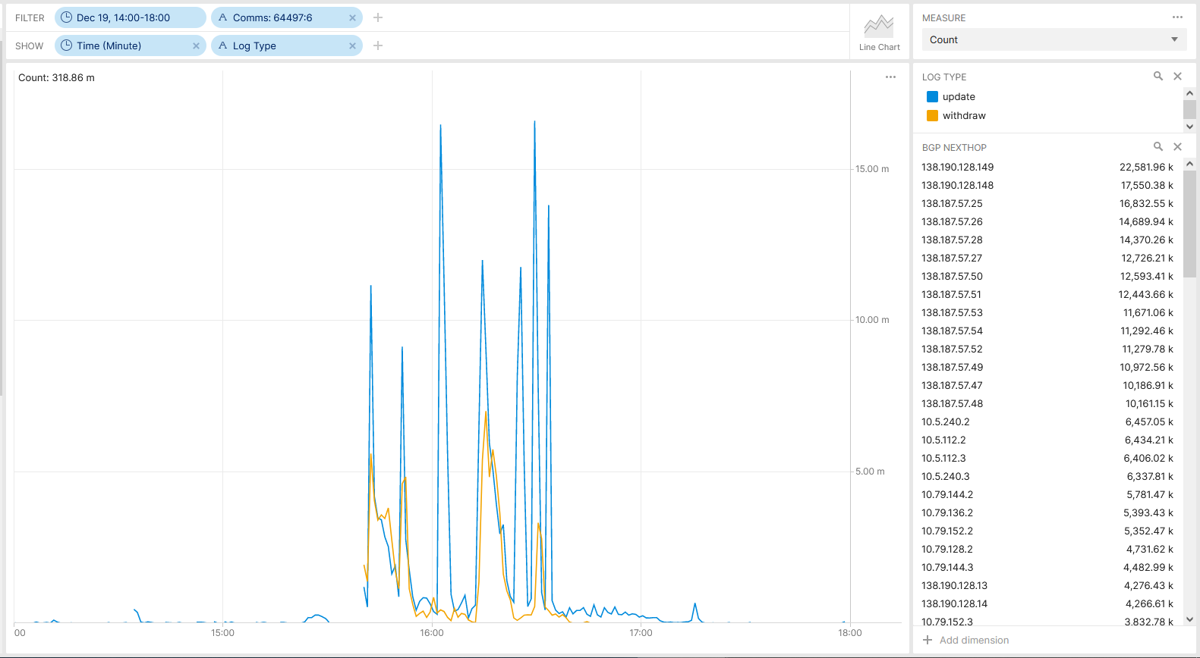



Maximum Prefix BGP Peer State Change What have happened
Long time ago, both a set of Inter-AS Option A ASBR routers started to log and notify through SNMP traps warning messages that 20% of the configured BGP maximum-prefix limit has been crossed. This has been visualized in an NMS with severity yellow and not being observed.
At 15:40 the configured limit has been reached and both redundant peers were shutdown 4 times for 10 minutes each at the same time.
At 15:41 Network Anomaly Detection observed on L3 VPN 64497:6 a potential issue with a concern score of 0.26 and at 16:02 reached the alert level of 0.30 and was not observed by 7x24 NOC.
At 15:41-45 network operation center noticed Swiss wide connectivity interruption on application level. Unable to identify based on network metrics, suspecting due to scope a specific set of ASBR's and notified responsible platform team.
At 16:10 ASBR team reached out to MPLS core team. At 16:20 BGP maximum prefix limit of peering was increased and peering state resolved.
BMP route-monitoring update/withdrawals on 64497:6

Slide 7

Maximum Prefix BGP Peer State Change Network Telemetry Coverage
IPFIX configured on P and PE MPLS-SR nodes on MPLS and IPv4/6 VRF unicast enabled interfaces. Capturing L3 IPv4/6 and L2 Ethernet overlay customer data plane and underlay MPLS provider data plane metrics on MPLS enabled interfaces, and IPv4/6 and L2 Ethernet overlay customer data plane metrics on IPv4/6 VRF unicast enabled interfaces.
-> Shape, means that we are engaged in IETF standardization, vendor implementations and running code. IPv4/6 unicast customer data plane visibility is in vital, MPLS data plane visibility is in applied, On-Path delay is in operational stage.
BMP Adj-RIB In post-policy on BGP VPNv4 /6 and IPv4/6 VRF unicast peers and Local-RIB on all RIB's configured on MPLS PE's. BMP Adj-RIB In post-policy on BGP VPNv4 /6 peers on Route Reflectors configured.
-> Shape, means that we are engaged in IETF standardization, vendor implementations and running code. BMP Local RIB data plane visibility is in applied, BMP Path Marking is in operational stage.
YANG Push Legacy on most nodes enabled but not relevant for this use case.
-> Take, means that current YANG-Push legacy implementation is used without any vendor code change and is in accepted stage. However, IETF YANG-Push is shape and is in operational state.

Slide 8
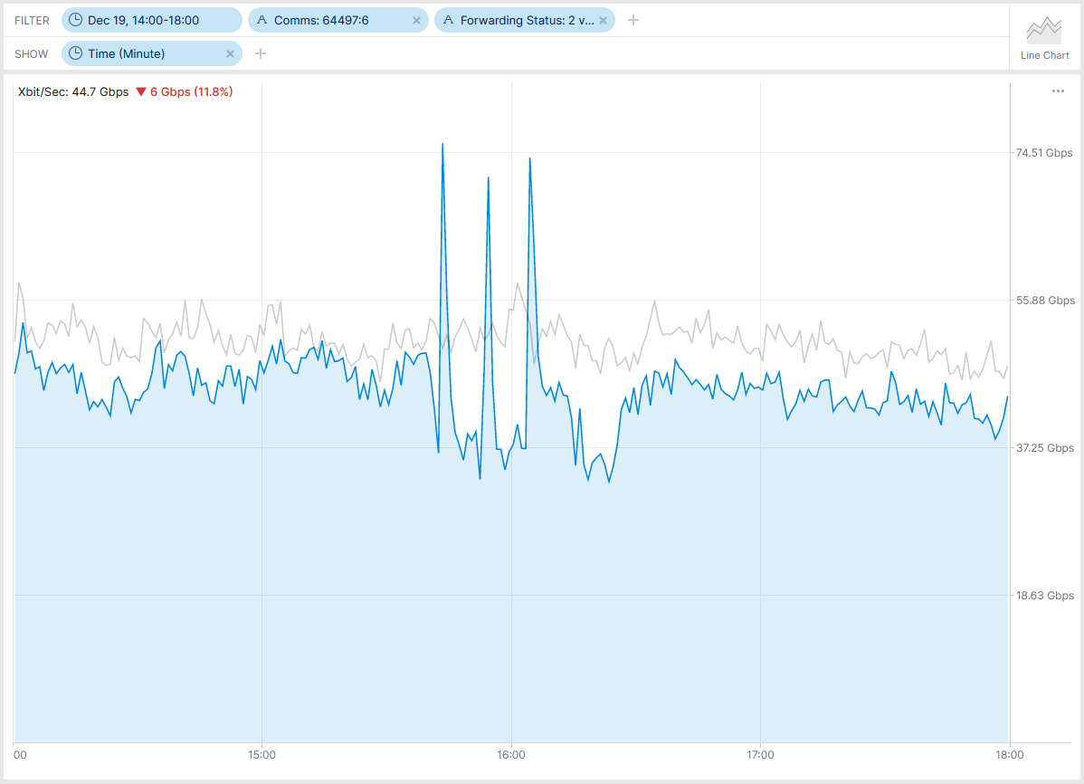
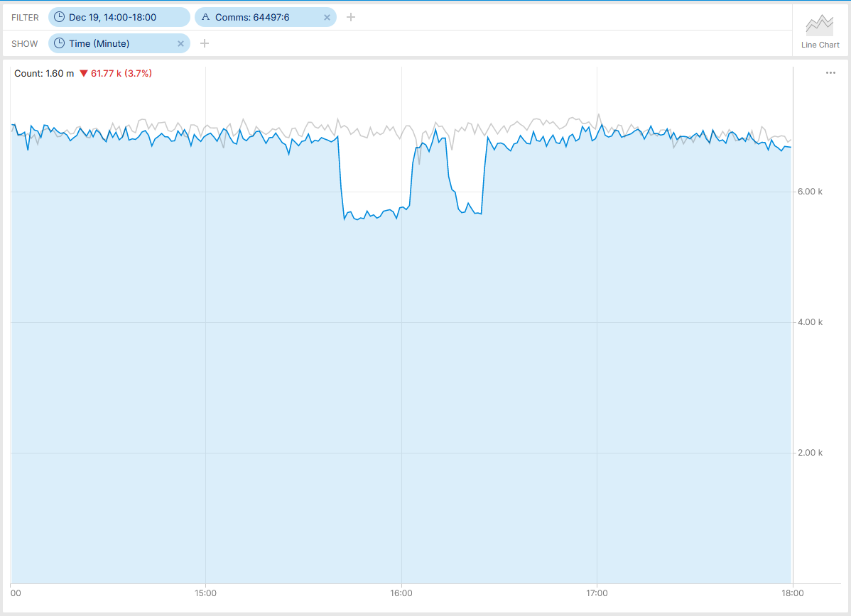
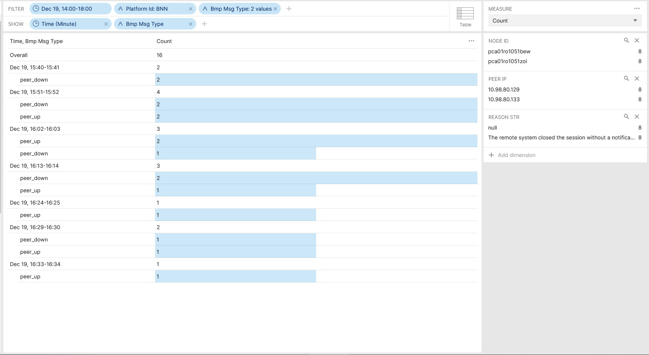
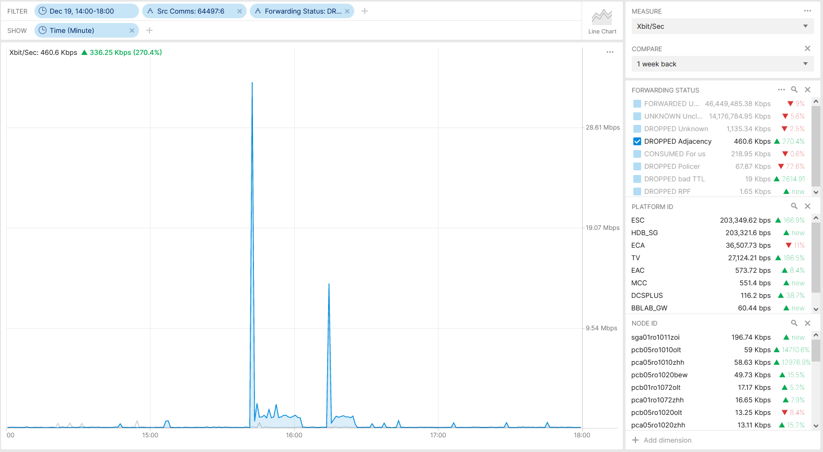
Postmortem, Maximum Prefix BGP Peer State Change Which operational metrics covered
IPFIX configured on PE and Inter-AS Option A ASBR nodes.
Traffic Drop with Reason Code Adjacency at TV was unrelated.
BMP ADJ-RIB In pre-policy on BGP VPNv4 /6 and IPv4/6 VRF unicast peers configured on MPLS PE's. BMP ADJ-RIB In pre-policy on BGP VPNv4 /6 on Route Reflectors.
BMP peer_down reports that it is type 4 (Remote system closed, no data) instead of type 1 (Local system closed, NOTIFICATION PDU follows) due to CSCwi61922.
Missing Traffic 64497:6
Flow Count Drop 64497:6
BMP Peer State Change 64497:6
Traffic Drop 64497:6

Slide 9
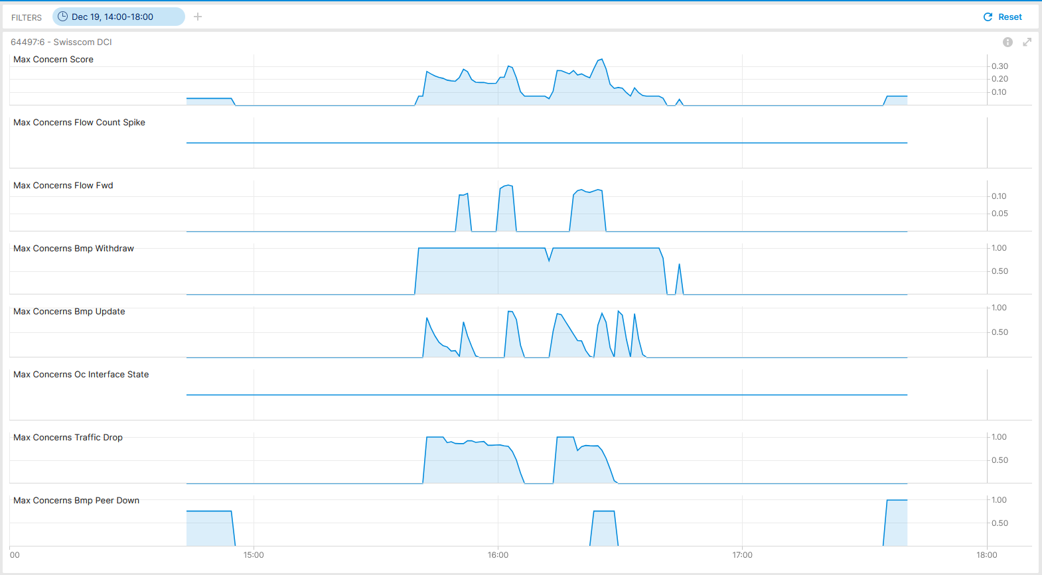

Postmortem, Maximum Prefix BGP Peer State Change What Network Anomaly Detection observed, Live
Max Concern Score: 0.36
Traffic Drop: 1.0 Missing Traffic: 0.13
BMP Update/Withdraw: 1.0
BMP Peer Down: 0.76
BMP route-monitoring Update/Withdraw recognized topology change.
BMP peer Down recognized peering state change delayed due to potential data processing lag.
Interface Down/Up check did not apply.
Traffic Drop check recognized forwarding drop.
Missing Traffic recognized that connectivity is impaired.
Flow Count Spike did not apply.
Overall: 4 out of 6 checks have detected a customer impact inside of monitoring domain. Works as designed.
Cosmos Bright Lights Anomaly Detection – 64497:6 SC-DCI

Slide 10
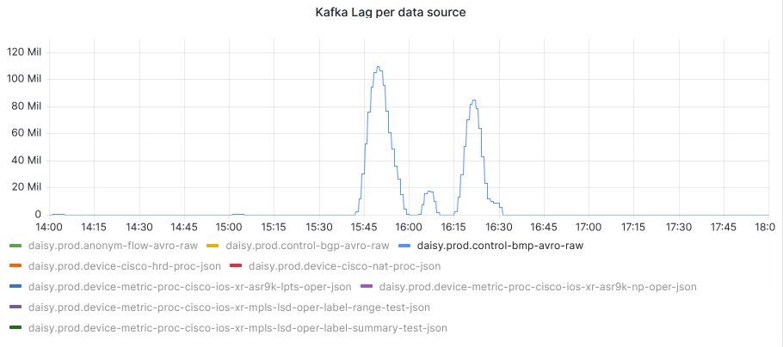
What went well?
Anomaly Detection rules detected outage based on BMP update/withdrawal and peer_down, IPFIX flow count drop, traffic drop and missing traffic. Works as designed.
Postmortem
What to do next?
Record incident in Cosmos Bright Lights lab. -> Done!
Analyze why (TSDB ingestion delay?) not all BMP peer_down where being recognized by BMP peer_down check.
What could be improved?
Consider to implement capacity management and trend detection analytical use case for BGP max prefix configured peers, BGP Local RIB path count and BGP process memory.
draft-ietf-grow-bmp-rel authors added in -02 revision the support of two reason code TLV's for prefixes crossing the warning and the maximum threshold.
draft-msri-grow-bmp-bgp-rib-stats authors added in revision -03 BMP statistics definitions describing how many routes until maximum prefix count has been reached.
BMP peer_down reason code is 4 instead of 1 on Cisco IOS XR. Addressed and confirmed in SR 696692110. CSCwi61922 bugfix verified.
BGP notification sub-code support in NetGauze data collection verified.

Slide 11
Maximum Prefix BGP Peer State Change Want more?
You are interested to see another Network Analytics Network Incident Postmortems? Please consider to attend SRv6OPS working group session on Tuesday 16:30 – 17:30.
You want to contribute to the Network Anomaly Detection draft-ietf-nmop-network-anomaly-architecture and YANG to Message Broker Integration draft-ietf-nmop-yang-message-broker-integration and learn more? Please attend NMOP working group session on Tuesday 09:30 – 11:30, 18:00 – 19:00 for the hackathon related experiments or go onto the mailing list and contribute to the discussion.

